Slide 1
Module 5 Oracle SQL Analytic Functions
Lesson 5: Functions for Ratio Comparisons
Notes:
Welcome to Lesson 5 of Module 3 on Oracle SQL analytic functions
Opening question
Are analytic functions used more directly (by business analysts) or indirectly by business intelligence tools

Slide 2
Lesson Objectives
Understand concepts about cumulative distribution functions
Write SELECT statements using functions for ratio comparisons
Reflect about the importance of ratio comparisons
Notes:
Part 3 extends part 2 with additional Oracle analytic functions for quantitative ranking.
Objectives:
Understand usage of reporting ratio functions for additive measures
Understand differences in cumulative distribution and percentage ranking
Understand examples for quantitative ranking (cumulative distribution, percentage distribution, and ratio to report)

Slide 3
Motivation
Ratio comparisons common in business intelligence
More precise than rankings
Contribution ratios
Part of a whole
Share of total sales for each division
Distribution ratios
Size of subsets compared to a population
Threshold for top 5% of unit sales
Notes:
Ratio comparisons
More precise than qualitative (relative) rankings
Appropriate for additive measures and ordered columns
Contribution ratios for showing each row’s contribution to partition for additive measures
Distribution ratios showing cumulative number of rows as a ratio
Ordered columns such as salary and product rating
Use row count or rank in denominator

Slide 4
Ratio Comparison Functions
Ratio_To_Report
Contribution ratios for additive columns
Ratios sum to 1
Cume_Dist and Percent_Rank
Distribution ratios for ordered columns
Differ slightly on range
Maximum value of 1
Notes:
Reporting ratios for additive measures such as sales (store sales as part of total sales)
Ranking functions for ordered columns (at least partial ordering)
Distribution ratios for questions involving top or bottom percentages
80/20 situation such as top 20% produce 80% of earnings
Typically used for dimension tables alone

Slide 5
Ratio_To_Report Example
Contribution ratio on sum of dollar sales by year and customer city
Partition on year
Order result by year and descending sum of sales
SELECT TimeYear, CustCity, SUM(SalesDollar) AS SumSales,
RATIO_TO_REPORT(SUM(SalesDollar))
OVER (PARTITION BY TimeYear) AS SumSalesRatio
FROM SSCustomer, SSSales, SSTimeDim
WHERE SSSales.CustID = SSCustomer.CustId
AND SSSales.TimeNo = SSTimeDim.TimeNo
GROUP BY TimeYear, CustCity
ORDER BY TimeYear, SUM(SalesDollar) DESC;
Notes:
RATIO_TO_REPORT function
Identity sales contribution of each by year
Quantitative ranking to provide more precise ranking than rank function
Use for additive measures
Results in 2010 partition
2010 partition
Ratios for sum of sales
Order by year and sum of sales (descending)
Littleton has more than 50% of total sales
Englewood has least ratio of sales (about 4%)

Slide 6
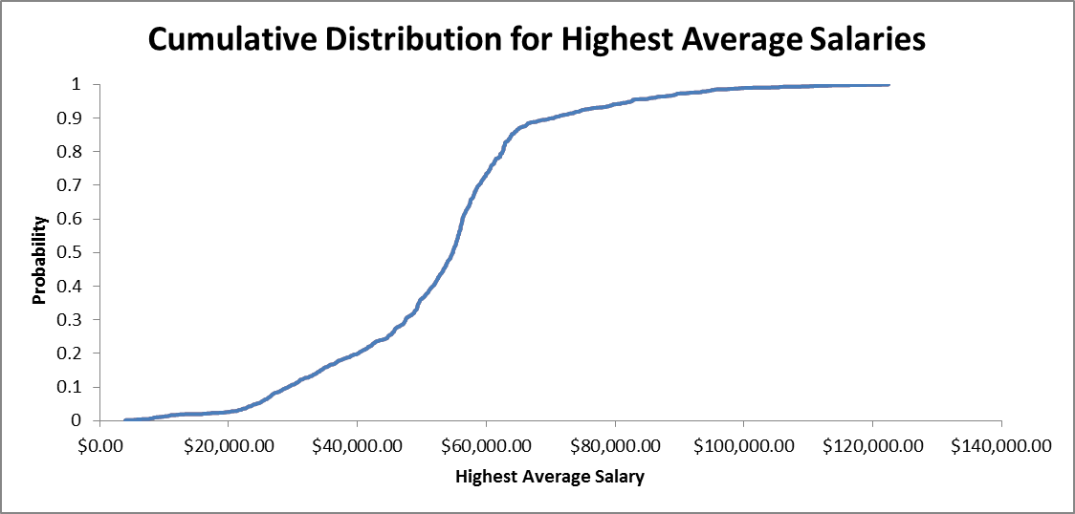
Cumulative Distribution
Cume_Dist
(rows preceding inclusive) / N
Value range: > 0 to 1
Cume_Dist(54,950) = 0.50987 (801/1571)
Percent_Rank
(rank-1) / (N-1)
Value range: ≥ 0 to 1
Percent_Rank(54,950) = 0.50955 (800/1570)
Notes:
Cumulative distribution:
a function that gives the probability that a random variable is less than or equal to the independent variable of the function
the probability that a random variable X takes on a value less than or equal to a number x.
Highest average salaries
Values that starting pensions are defined
Half of HAS is less than $54,711
Two versions of CDF in Oracle
PERCENT_RANK: rank – 1 / total number of rows – 1
CUME_DIST: number of rows preceding including the value / total number of rows

Slide 7
Cumulative Distribution Example
Cumulative distribution functions on item unit price
Display item name, rank, percent rank, row number, and cumulative distribution
SELECT ItemName, ItemUnitPrice,
RANK() OVER (ORDER BY ItemUnitPrice) As RankUnitPrice,
PERCENT_RANK()
OVER (ORDER BY ItemUnitPrice) As PercentRankUnitPrice,
ROW_NUMBER()
OVER (ORDER BY ItemUnitPrice) As RowNumUnitPrice,
CUME_DIST()
OVER (ORDER BY ItemUnitPrice) As CumDistUnitPrice
FROM SSItem;
Notes:
PERCENT_RANK function
Indicates cumulative distribution of ordering column values
ItemPrice of 38 represents 33% of all rows
No function name parameter
Uses rank in numerator
First row is always 0
Last row is always 1
Second row: 1/9 (rank-1) / (N-1) where N is the total number of rows
(rank in its partition - 1) / (total number of rows in the partition - 1)
Third row 2/9
Identical percentage value for ties
CUME_DIST function
Indicates cumulative distribution of ordering column values
No function name parameter
Number of values in result coming before and including current row in the specified order / N
<= for ascending order
>= for descending order
First row: 1/10 (1 row with unit price <= 12) / N where N is the total number of rows
Second row: 2/10 (2 rows with unit price <= 14.99) / N
Identical distribution values for ties

Slide 8
Example with Equal Values
Cumulative distribution functions on sum of sales units by customer name
Display customer name, rank, percent rank, row number, and cumulative distribution
SELECT CustName, SUM(SalesUnits) AS SumSalesUnits,
RANK() OVER (ORDER BY SUM(SalesUnits) ) AS RankSalesUnits,
PERCENT_RANK() OVER (ORDER BY SUM(SalesUnits) )
AS PerRankSalesUnits,
ROW_NUMBER()
OVER (ORDER BY SUM(SalesUnits)) As RowNumSalesUnits,
CUME_DIST() OVER (ORDER BY SUM(SalesUnits) ) AS CumDistSalesUnits
FROM SSSales, SSCustomer
WHERE SSSales.CUSTID = SSCustomer.CUSTID
GROUP BY CustName;
Notes:
Shows calculations for rows with the same values
Rows 3 and 4 have the same value for SumSalesUnits (636)
Percent_Rank: 2 / 8 (rank – 1) / (N – 1)
Cume_Dist: 4/9 (number of rows with SumSalesUnits <= 636) / N

Slide 9
Top Performers Example
Cumulative distribution function on item unit price
Only display top 30% of items with largest unit prices
Display item name, item brand, item unit price, and cumulative distribution
SELECT ItemName, ItemBrand, ItemUnitPrice, CumDistUnitPrice
FROM ( SELECT ItemId, ItemName, ItemBrand, ItemUnitPrice,
CUME_DIST()
OVER (ORDER BY ItemUnitPrice DESC) As CumDistUnitPrice
FROM SSItem ) X
WHERE CumDistUnitPrice <= 0.3;
Notes:
Smallest unit prices: 30% threshold
Nested query in FROM clause
Needed for the condition on the analytic function result
Analytic functions do not have a HAVING clause
Nested query generates analytic function (CUM_DIST) so that a WHERE condition can reference in the computed column in the outer query
PostgreSQL requires alias for a subquery in the FROM clause. X is the alias used. Oracle SQL does not require an alias unless it is needed for references to subquery columns that have same name as other columns in the query.

Slide 10
Additional Problems I
Example 5
Cumulative distribution (Cume_Dist) of dollar sales in Colorado (CO)
Remove duplicates
Display dollar sales and cumulative distribution
Example 6
Top performing (30%) customer zip codes by year on sum of dollar sales
Use either cumulative distribution function
Partition by year
Display year, store zip code, sum of dollar sales, and cumulative distribution
Order by year and cumulative distribution
Notes:
Use DISTINCT keyword in example 5 to eliminate duplicates
Example 6:
Need nested query in the FROM clause for top performers
First write statement to determine complete distribution
Solutions in a module 3 document

Slide 11
Additional Problems II
Example 7
Contribution ratio on sum of 2015 unit sales by month and item brand
Partition on month
Display month, item brand, sum of unit sales, and contribution ratio
Order result by month and descending sum of unit sales
Notes:
Example 7
Solutions in a module 3 document

Slide 12
Summary
Support common ratio comparisons in business intelligence
RATIO_TO_REPORT for contributions of additive columns to total
CUME_DIST and PERCENT_RANK for distribution ratios
Notes:
Common business analysis
More precise than relative rankings
Contributions of each division to total sales
Products within top 5% of unit sales
Quantitative rankings using ratios
RATIO_TO_REPORT for comparing contribution of additive measure
PERCENT_RANK and CUME_DIST for comparing the number of rows for a threshold value in ordered columns
Without analytic functions in SQL
Complex combinations of SQL statements and procedural coding: advanced SQL knowledge necessary
Poor performance as compiler will not optimize

